Slide 1
Capstone Project Building Basic predictive models over the NYC Taxi Trip dataset
Submitted By Date of Submission
Mamta Urade 28 Dec 2022

Slide 2
Contents:
Problem Definition
Data description
Data Exploration and Transformation
All the given task (Predictive Modelling)
Conclusion

Slide 3
Here's the Problem Definition:
Project: Building Basic predictive models over the NYC Taxi Trip dataset.
You are provided with the NYC Taxi Trip Dataset. This dataset contains information about the taxi trips that took place in different parts of New York City and how much time did that trip take to complete.
In this project, the following are the tasks you must complete and submitted.
Choose the most suitable evaluation metric and state why you chose it.
Build a benchmark model for the given dataset.
Build a K-Nearest neighbours’ model for the given dataset and find the best value of K.
Build a Linear model for the given dataset with regularisation. Attempt to interpret the variable coefficients of the Linear Model.
Build a Decision tree model for the given dataset. Attempt to interpret the variable importance.
Plot the following Bar plots:
0. train score of all the above models.
1. test (not validation!) score of all the above models.
2. Attempt to explain the observations from the plots (optional)

Slide 4
Data description:
id - a unique identifier for each trip
vendor_id - a code indicating the provider associated with the trip record
pickup_datetime - date and time when the meter was engaged
dropoff_datetime - date and time when the meter was disengaged
passenger_count - the number of passengers in the vehicle (driver entered value)
pickup_longitude - the longitude where the meter was engaged
pickup_latitude - the latitude where the meter was engaged
dropoff_longitude - the longitude where the meter was disengaged
dropoff_latitude - the latitude where the meter was disengaged
store_and_fwd_flag - This flag indicates whether the trip record was held in vehicle memory before sending to the vendor because the vehicle did not have a connection to the server (Y=store and forward; N=not a store and forward trip)
trip_duration - (target) duration of the trip in seconds

Slide 5
Data Exploration and Transformation:
The dataset contains 739322 rows and 11 columns.
Categorical variables: id, pickup_datetime, dropoff_datetime, store_and_fwd_flag
Continuous variables: vendor_id, passenger_count, pickup_longitude, pickup_latitude dropoff_longitude, dropoff_latitude
Target Exploration: trip_duratation
Here the trip_duration is a continuos variable, which determines that the problem is a regression problem.
No null values present.
No missing values present in our dataset.
Here we are import the data, describe the data, see distribution in the data, do statistical testing, analysis, visualization, null values check, standardize data, create train test split, use different models, and then comparing the results and plot a graph.

Slide 6
All the given task results (Predictive Modelling)

Slide 7
1. Choose the most suitable evaluation metric and state why you chose it.
Basic Predictive Modeling
I have used Root mean squared error RMSE as the evaluation metric since the target variable is continuous variable. RMSE is most commonly used evaluation metrics for regression problems since it brings down the unit of the difference between predicted and actual values to the same unit as the target variable .
The reason behind it is that it is one of the most efficient evaluation metric used on regression problems and it is easy to understand and evaluate .
So the evalutation metric for this model is - Root Mean Squared Error(RMSE)
RMSE is a very simple metric to be used for evaluation. Since, we will be comparing our models and we will create a benchmark model as a baseline, RMSE will easy to compare these different models. Lower, the value of RMSE, better the model. It will help in getting the elbow curve.

Slide 8
Evaluation Metrics
Evaluation metrics are used to measure the quality of the statistical or machine learning model. Evaluating machine learning models or algorithms is essential for any project. There are many different types of evaluation metrics available to test a model.
Why We require Evaluation Metrics?
Most beginners and practitioners most of the time do not bother about the model performance. The talk is about building a well-generalized model, Machine learning model cannot have 100 per cent efficiency otherwise the model is known as a biased model. which further includes the concept of overfitting and underfitting.
It is necessary to obtain the accuracy on training data, But it is also important to get a genuine and approximate result on unseen data otherwise Model is of no use.
So to build and deploy a generalized model we require to Evaluate the model on different metrics which helps us to better optimize the performance, fine-tune it, and obtain a better result.
If one metric is perfect, there is no need for multiple metrics. To understand the benefits and disadvantages of Evaluation metrics because different evaluation metric fits on a different set of a dataset.

Slide 9
Different Evaluation metrics:
1) Mean Absolute Error(MAE)
MAE is a very simple metric which calculates the absolute difference between actual and predicted values.
2) Mean Squared Error(MSE)
MSE is a most used and very simple metric with a little bit of change in mean absolute error. Mean squared error states that finding the squared difference between actual and predicted value.
3) Root Mean Squared Error(RMSE)
As RMSE is clear by the name itself, that it is a simple square root of mean squared error.
4) R Squared (R2)
R2 score is a metric that tells the performance of your model, not the loss in an absolute sense that how many wells did your model perform.
5) Adjusted R2
Adjusted R2 is a corrected goodness-of-fit (model accuracy) measure for linear models. It identifies the percentage of variance in the target field that is explained by the input or inputs.

Slide 10
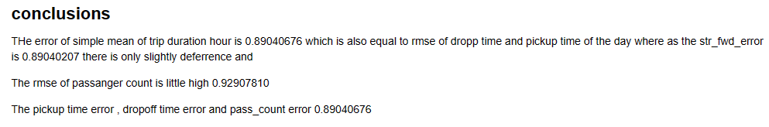
2. Build a benchmark model for the given dataset.

Slide 11
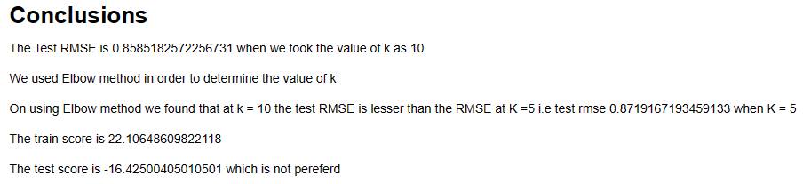
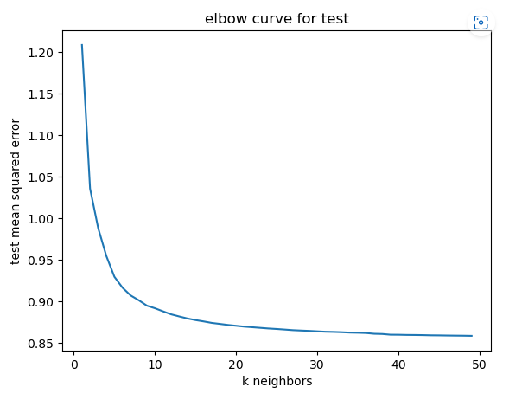
3. Build a K-Nearest neighbours’ model for the given dataset and find the best value of K.

Slide 12
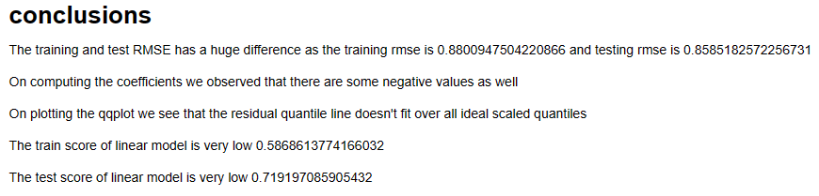
4. Build a Linear model for the given dataset with regularization. Attempt to interpret the variable coefficients of the Linear Model.

Slide 13
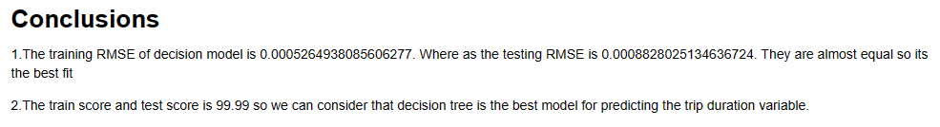
5. Build a Decision tree model for the given dataset. Attempt to interpret the variable importance.

Slide 14
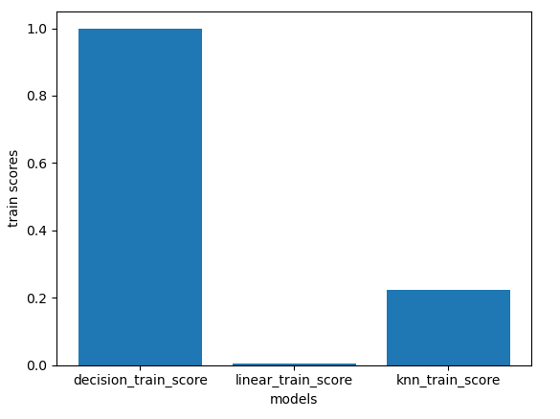
6.Plot the following Bar plots:
0. train score of all the above models.

Slide 15
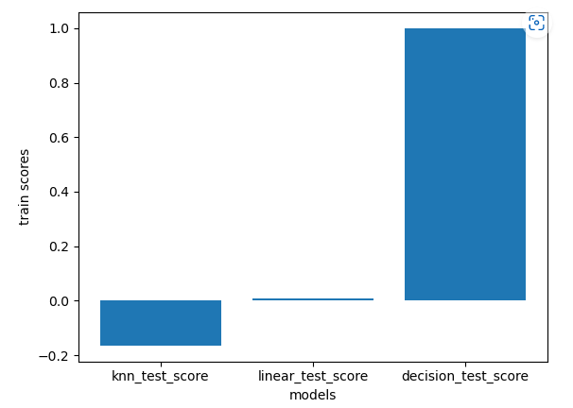
1. test (not validation!) score of all the above models.
2. Attempt to explain the observations from the plots (optional)

Slide 16
2. Attempt to explain the observations from the plots (optional)
from above graph we can see that the best model among K-Nearest neighbours, Linear Regression model and Decision Tree the best one is Decision Tree in train score.

Slide 17
Conclusion
According to the Problem statement, we come up with some results. These results performing various task, such as Basic Predictive Modeling, choose evaluation metric , Benchmark model, KNN, linear model, decision tree model and plotting the graph.
I have used Root mean squared error RMSE as the evaluation metric since the target variable is continuous variable. RMSE is most commonly used evaluation metrics for regression problems since it brings down the unit of the difference between predicted and actual values to the same unit as the target variable .
Elbow method is best way to determine the value of k.
From the graph it is evident that the decision tree is giving the best score and suitable for prediction of data.

Slide 18
Thank you

